Slide 1

ARTIFICIAL INTELLIGENCE
&
MACHINE LEARNING
SESSION NO : 19
Variable Types, Scaling (standardization, normalization), encoding (one hot, embeddings).

Slide 2
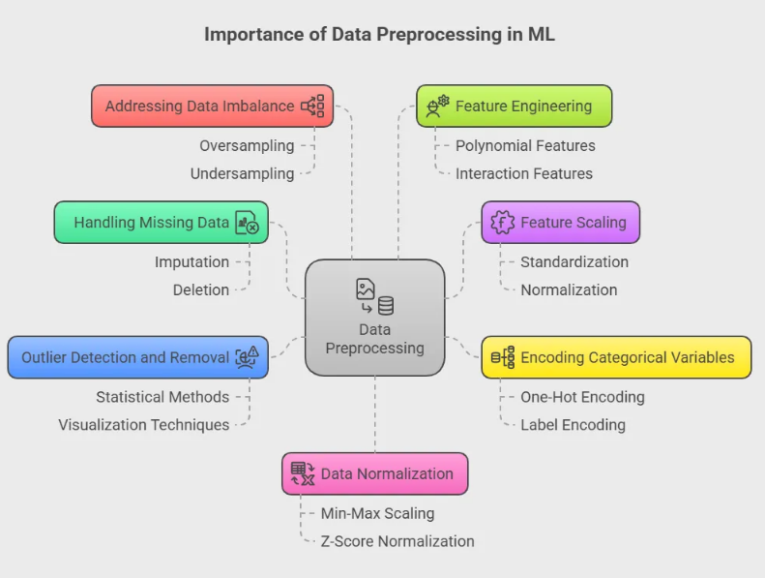
The Importance of Data Preprocessing
Raw data is rarely model-ready. Preprocessing is the essential step of cleaning and transforming raw data into a format that machine learning algorithms can understand effectively.

Slide 3
The Importance of Data Preprocessing
Algorithm Requirements: Many algorithms (e.g., SVM, K-Means, Gradient Descent-based models) require scaled data to perform correctly.
Performance: Improves model convergence speed and accuracy.
Fairness: Prevents features with larger scales (like salary) from dominating those with smaller scales (like age).
Compatibility: Algorithms only work with numerical values.

Slide 4
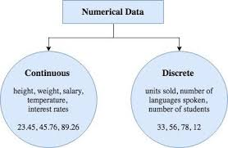
Know Your Data: Variable Types
Categorical vs. Numerical Data
Categorical (Qualitative)
Represents groups or categories.
Nominal: No order (e.g., Country, Color, Product Type).
Ordinal: Has a meaningful order (e.g., Education Level, Satisfaction Rating (Low, Med, High)).
Numerical (Quantitative)
Represents measurable quantities.
Discrete: Countable integers (e.g., Number of Children, Page Views).
Continuous: Infinite possible values (e.g., Height, Weight, Temperature).

Slide 5
Problem: Features on Different Scales
The Dominating Feature Problem
Algorithms using distance calculations are highly sensitive to feature scales.
Example: K-Nearest Neighbors (KNN)
Feature 1: Age (Range: 20 - 80 years)
Feature 2: Salary (Range: 40,000 - 120,000 USD)
The distance between points will be dominated by Salary, making Age almost irrelevant to the model's calculations.
Solution: Feature Scaling

Slide 6
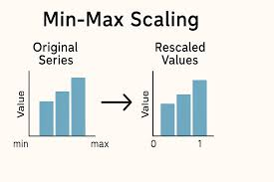
Solution: Feature Scaling - Normalization (Min-Max Scaling)
Normalization (Min-Max Scaling)
Rescales features to a fixed range, usually [0, 1].
Formula:
X_new = (X - X_min) / (X_max - X_min)
Pros:
Simple to implement.
Preserves the original distribution.
Good for algorithms that don't assume a distribution (e.g., KNN, Neural Networks).
Cons:
Sensitive to outliers. A single extreme outlier can compress the rest of the data.
Use when: You know the data is bounded or you have no major outliers.

Slide 7
Solution: Feature Scaling - Normalization (Min-Max Scaling)
Example:
Imagine we have a dataset of houses with a 'SqFt' feature.
Original Data: [1500, 2000, 3500, 1000]
Find min(SqFt) = 1000
Find max(SqFt) = 3500
Let's scale the first value, 1500:
(1500 - 1000) / (3500 - 1000) = 500 / 2500 = 0.2
Let's scale all values:
1500 -> (1500-1000)/2500 = 0.2
2000 -> (2000-1000)/2500 = 0.4
3500 -> (3500-1000)/2500 = 1.0
1000 -> (1000-1000)/2500 = 0.0
Scaled Data: [0.2, 0.4, 1.0, 0.0]
The data is now on a consistent scale from 0 to 1.

Slide 8
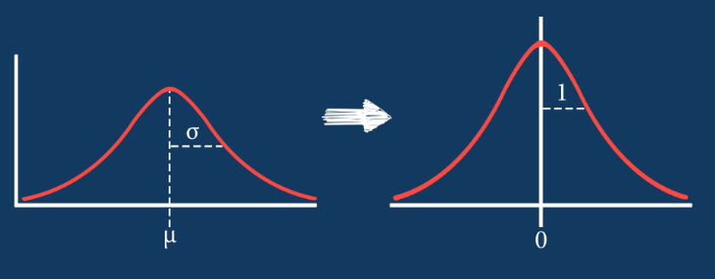
Solution: Feature Scaling - Standardization (Z-Score Normalization)
Standardization (Z-Score Normalization)
Rescales data to have a mean of 0 and a standard deviation of 1.
Formula:
X_new = (X - μ) / σ
Pros:
Less sensitive to outliers than Min-Max scaling.
Works well for algorithms that assume a Gaussian (normal) distribution (e.g., Linear Regression, Logistic Regression).
Cons:
Does not bound values to a specific range.
Use when: The data contains outliers or when the algorithm assumes a normal distribution.

Slide 9
Solution: Feature Scaling - Standardization (Z-Score Normalization)
Example:
Using the same 'SqFt' data: [1500, 2000, 3500, 1000]
Step 1: Calculate the Mean (μ)
(1500 + 2000 + 3500 + 1000) / 4 = 8000 / 4 = 2000
Step 2: Calculate the Standard Deviation (σ)
  Find the differences from the mean:
  [1500-2000, 2000-2000, 3500-2000, 1000-2000] = [-500, 0, 1500, -1000]
  Square the differences:
  [250000, 0, 2250000, 1000000]
  Calculate the mean of these squares (this is the Variance):
  (250000 + 0 + 2250000 + 1000000) / 4 = 3,500,000 / 4 = 875,000
  Take the square root of the variance to get σ:
  sqrt(875,000) ≈ 935.41
Step 3: Apply the Formula to each value
  1500: (1500 - 2000) / 935.41 ≈ (-500) / 935.41 ≈ -0.535
  2000: (2000 - 2000) / 935.41 = 0 / 935.41 = 0
  3500: (3500 - 2000) / 935.41 ≈ 1500 / 935.41 ≈ 1.604
  1000: (1000 - 2000) / 935.41 ≈ (-1000) / 935.41 ≈ -1.069
Standardized Data: [-0.535, 0, 1.604, -1.069]
The data now has a mean of 0 and a standard deviation of ~1

Slide 10
Comparison Table
Feature | Scaling (Min-Max) | Standardization (Z-Score)
Purpose | Changes the range of data (e.g., to [0, 1]). | Changes the distribution to mean=0, std=1.
Formula | (X - X_min) / (X_max - X_min) | (X - μ) / σ
Result Range | A predefined range (e.g., [0, 1]). | No fixed range. Can be any real number.
Affected by Outliers? | Yes, heavily. Min/Max are skewed by outliers. | Less, as it uses mean/std. More robust.
Use Case | Neural networks requiring input values between 0-1. Algorithms that rely on gradient descent. | Algorithms that assume centered data (e.g., SVM, Linear Regression, PCA). Most common default choice.
Example Algorithms | K-Nearest Neighbors, CNNs | SVMs, Logistic Regression, PCA, LDA

Slide 11
Encoding Categorical Variables: The Problem
Machines Don't Speak English
Machine learning models are mathematical constructs. They require numerical input.
We cannot do this:
model.fit([["UK"], ["USA"], ["France"]])
We must convert text labels to numbers. But how?
Incorrect Approach: Label Encoding (0, 1, 2)
UK=0, USA=1, France=2
Problem: The model might incorrectly assume an order (France > USA > UK), which doesn't exist for nominal data.

Slide 12
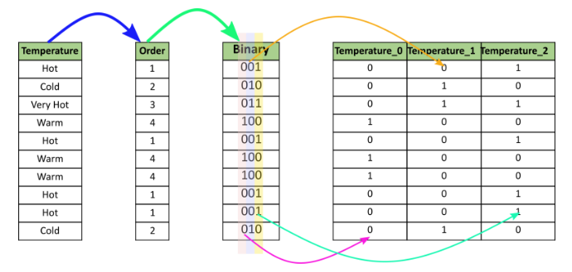
Encoding Solution #1: One-Hot Encoding
One-Hot Encoding
Creates new binary (dummy) columns for each category.

Slide 13
Encoding Solution #1: One-Hot Encoding
Pros:
Prevents false ordinal relationships.
Works well with nominal data.
Cons:
Curse of Dimensionality: If a category has many unique values (e.g., Zip Code), it creates many new columns, making the dataset sparse.

Slide 14
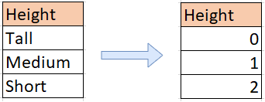
Encoding Solution #2: Label Encoding
Label Encoding
Only use Label Encoding for Ordinal Variables where the order is meaningful.
Example: Education Level
High School = 0
Bachelor's = 1
Master's = 2
PhD = 3
Here, the numerical order correctly represents the inherent order of the categories.
Do NOT use for nominal data.

Slide 15
Encoding Solution #3: Embeddings (Advanced)
Embeddings for High-Cardinality Data
An advanced technique that learns a meaningful, lower-dimensional representation of categories.
Instead of a sparse one-hot vector [0,0,1,0,...,0], an embedding is a dense vector like [0.24, -0.87, 0.19].
Key Benefit:
Similar categories (e.g., "Dog" & "Cat") will have similar vector representations.
Learned automatically by models like Neural Networks during training.
Commonly used in NLP (Word2Vec) and for user/item IDs in recommendation systems.

Slide 16
References
Books:
Book: Hands-On Machine Learning with Scikit-Learn, Keras, and TensorFlow
Author: Aurélien Géron
Editions: 3rd Edition (2022) is best, but 2nd is also excellent.
Book: An Introduction to Statistical Learning with Applications in R or Python
Authors: Gareth James, Daniela Witten, Trevor Hastie, Robert Tibshirani
Book: The Elements of Statistical Learning (ESL)
Authors: Trevor Hastie, Robert Tibshirani, Jerome Friedman
Web Link:
http://www.statlearning.com/

Slide 17
THANK YOU

